Slide 1
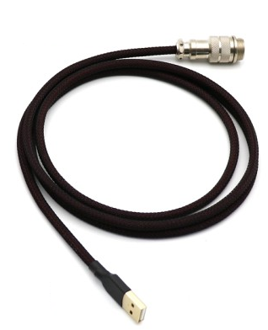
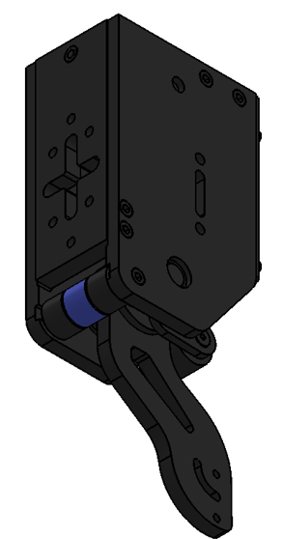



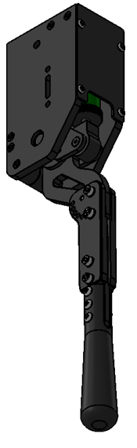


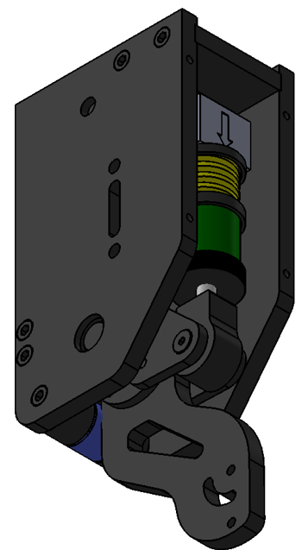
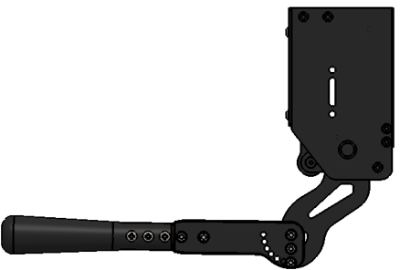
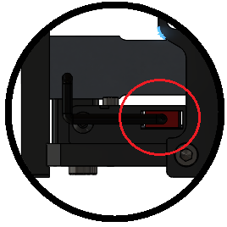
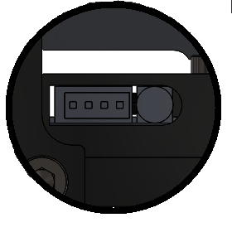
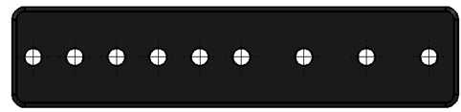
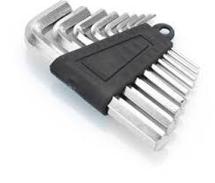
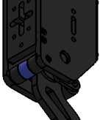
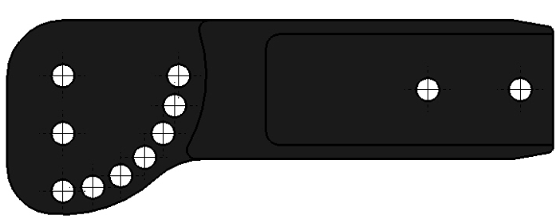
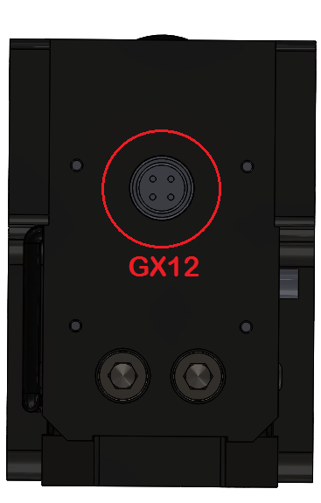
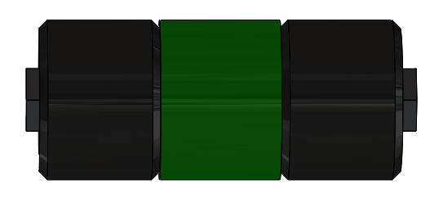
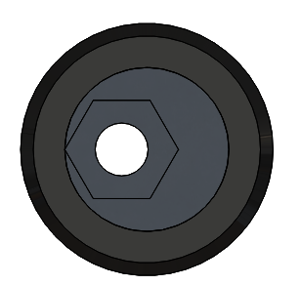


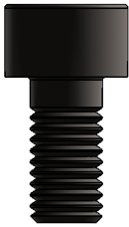
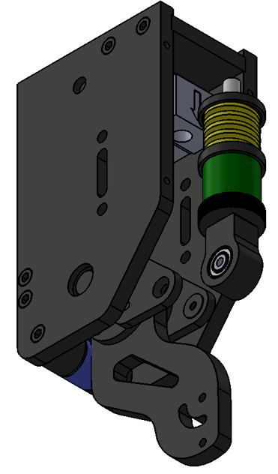
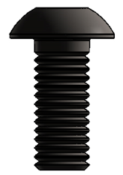
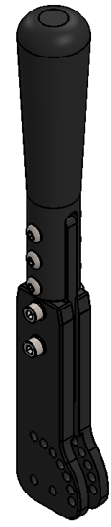
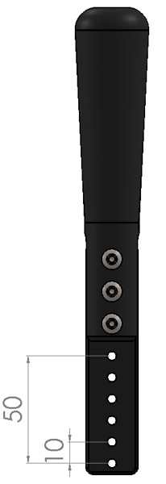
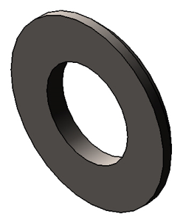
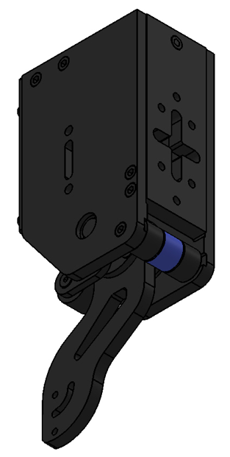

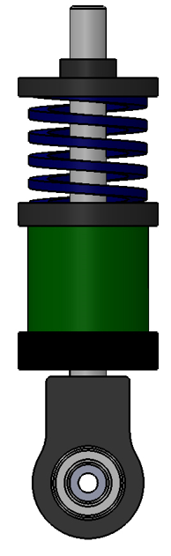

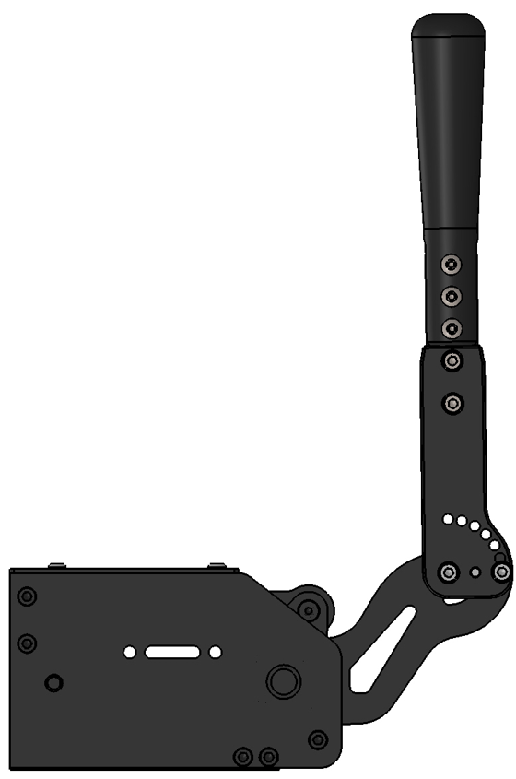
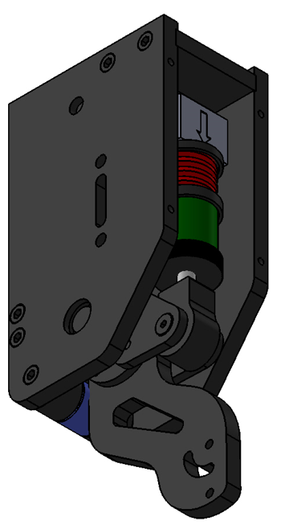
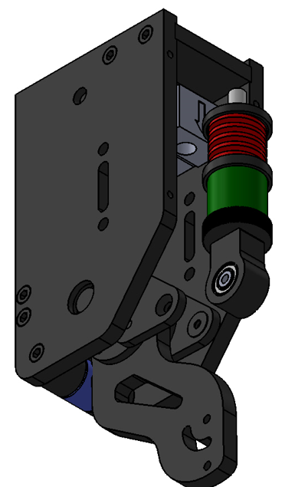
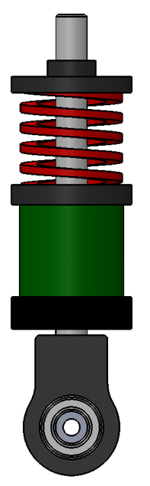









 | Content | Connection | Adjust Handbrake
Exchange Spring |  | Set up
VNM HANDBRAKE V1.5
Quick Guide
2
1
On the left side of the Handbrake: XH2.54-4P port for load cell connection
On the right side of the Handbrake is:
1. XH2.54-4P (ST-link) port for updating firmware
2. Button DFU/Game Mode
4
Adjust Spring & elastomer:
Twist the threaded cap:
Clockwise: Heavier pull force
Counter-clockwise: Lighter pull force
+ -
5
6
3
7
1
2
Adjust the angle of inclination:
Remove the 2 bolts on both sides,
Pull out the blue endstop part,
Choose the angle of inclination by rotating the blue endstop part,
Push the blue endstop part in the sliding slot,
Tighten the bolts.
X2
1. VNM Handbrake V1.5 body
2. Red (stiffest), blue (stiffer) springs
3. Allen key set
4. USB A male – GX12 male cable
5. Handle
6. Handle extension
7. 90 degree conversion adapter (2 pcs)
At the bottom of the Handbrake: GX12 female port
0$°$
M5x10
M5x12
M5x10
X4
Remove bolts
X6
X4
7 angle options
15$°$
X5
30$°$
M5x20
45$°$
X1
X2
90$°$
75$°$
60$°$
Remove bolts
X1
Choose the appropriate handle height
X1
OR
Choose the appropriate angle/inclination
Tighten bolts
Tighten bolts
Handbrake V1.5 set up for 0$°$ handle
VNM Handbrake V1.5 set up for 90$°$ handle

